Slide 1

Retail Stock Trading & PnL Analysis
Unlocking insights from historical market data.

Slide 2
Project Overview
Analyze Performance
Portfolio Profitability
Actionable Insights
Retail stock trading performance analysis.
Understand stock-level and sector contribution.
Interactive dashboard for informed investment.

Slide 3
Business Objectives
1
2
3
Evaluate Profitability
Identify Stocks
Analyze Sectors
Overall portfolio performance over time.
Top-performing and underperforming assets.
Sector-wise contribution to PnL.
4
5
Assess Risk
Enable Interactivity
Volatility of individual stocks.
Filters for year, sector, and stock.

Slide 4
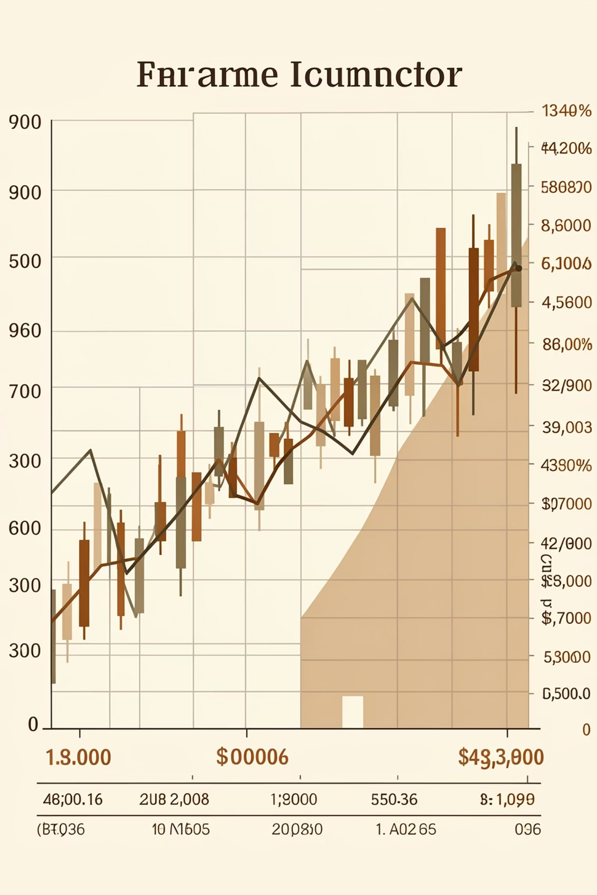
Dataset Summary
Source & Scope
Key Features
Yahoo Finance: ~7,000 daily observations.
Stock details (symbol, sector)
Price data (open, high, low, close)
Trading activity (volume)
Performance metrics (daily return, PnL)
Time information (trading date)
15 Indian stocks
5 sectors: Banking, Energy, FMCG, IT, Manufacturing

Slide 5

Data Preparation & Transformation
Clean
Calculate
Structure
Raw data cleaned, daily returns and PnL computed, structured into a star schema for efficient analytics.

Slide 6
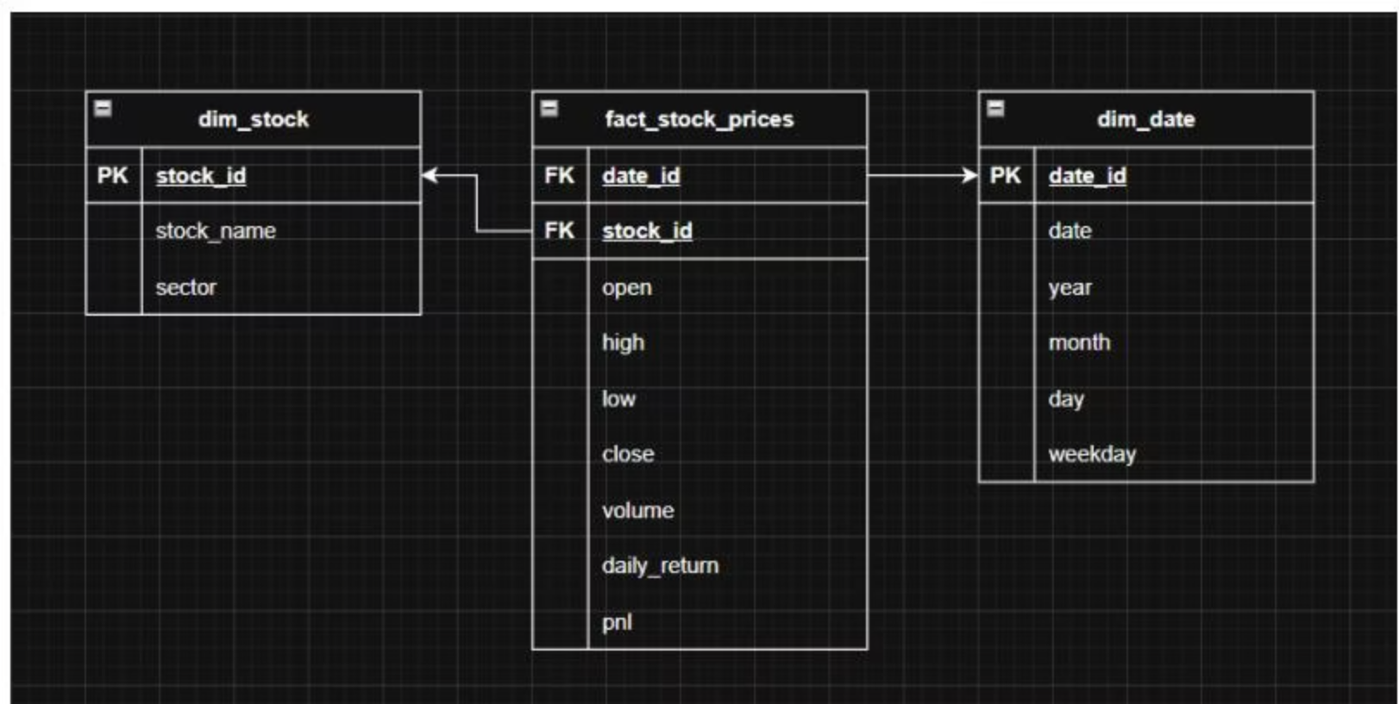
Star Schema for Scalable Analytics
Key Tables
dim_stock: stock_id, stock_name, sector
fact_stock_prices: date_id, stock_id, prices, volume, daily_return, pnl
dim_date: date_id, date, year, month, day, weekday
Enables efficient querying and scalable analytics.

Slide 7
Data Analysis using SQL
1
2
3
Top 5 Stocks
Highest PnL Sector
Positive PnL Ratio
TMCV.NS, BPCL.NS, ONGC.NS, ICICIBANK.NS, RELIANCE.NS
Manufacturing: 2151.10 total PnL.
TMCV.NS: 61% positive trading days.
Structured analysis answered key business questions on stock and sector performance.

Slide 8
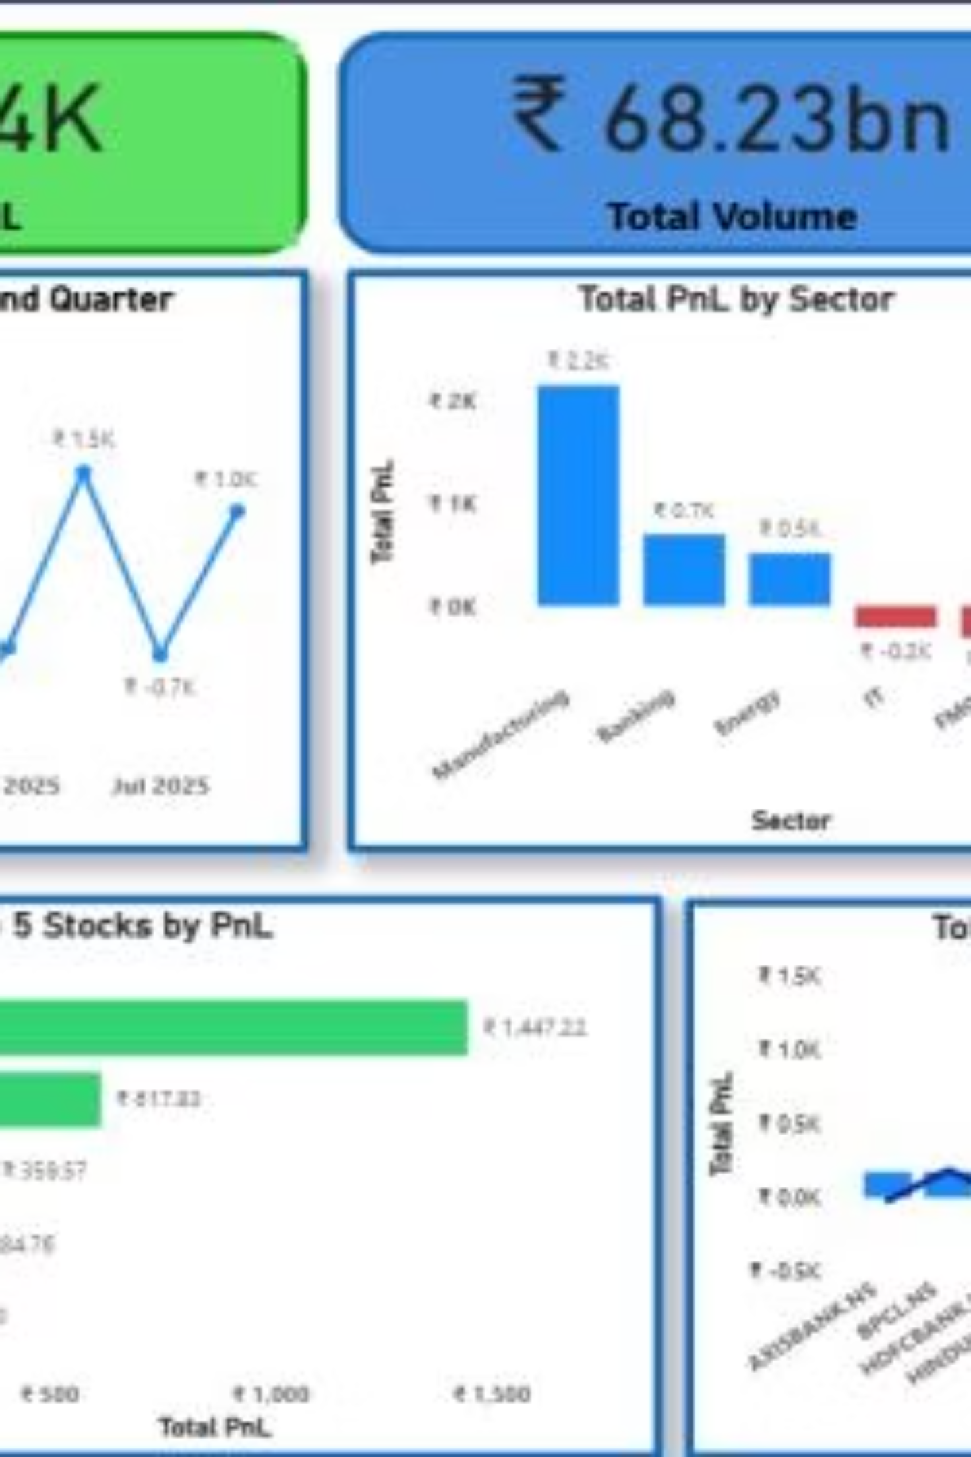
Dashboard & Visual Insights
Interactive Power BI dashboard for clear, intuitive insights.

Slide 9
Key Insights
Concentrated Profit
Sector Outperformance
Few stocks drive disproportionately high portfolio profit.
Certain sectors consistently outperform in PnL.
Risk vs. Return
Temporal Variation
High returns don't always mean low risk; volatility exists.
Portfolio performance varies significantly over time.

Slide 10
Business Value & Conclusion
Value Delivered
Project Summary
Effective portfolio monitoring
Identifies profitable/risky areas
Supports data-driven decisions
Clear financial communication
Comprehensive view of portfolio performance through financial metrics, risk analysis, and interactive visualization.
Bridges raw market data to informed investment analysis.

